Slide 1


Data Analysis of Indian Vehicle Market for launching new Electric Vehicles in India

Slide 2
AtliQ Motors is an automotive giant from the USA specializing in electric vehicles (EV). In the last 5 years, their market share rose to 25% in electric and hybrid vehicles segment in North America. As a part of their expansion plans, they wanted to launch their bestselling models in India where their market share is less than 2%. The chief of AtliQ Motors India wanted to do a detailed market study of existing EV/Hybrid market in India before proceeding further. Bruce gave this task to the data analytics team of AtliQ motors and Peter Pandey is the data analyst working in this team.

Slide 3
Here, we are provided the data of overall Indian vehicle market of FY-22,23 and 24. I have used Excel, Power BI, Power BI Dax to do proper data cleaning and visualization.
I have done data cleaning to remove small mistakes like correcting states spellings, modifying a few data-types, calculating Fiscal year, month, year from given dates using Power Query.
I have used the key metrics like Penetration Rate, CAGR for both Electric and non-electric vehicle categories to find detailed insights and find potentials of the success of Atliq Motors Electric Vehicles in upcoming Future.
Calculated each key metrics using DAX to make correct measures using the functions like SUM, CALCULATE, FILTER etc.
Here, the average unit price of 2-wheelers and 4-wheelers EV is assumed as Rs. 85000 and Rs. 1500000.

Slide 4
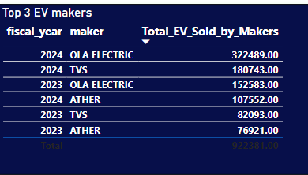
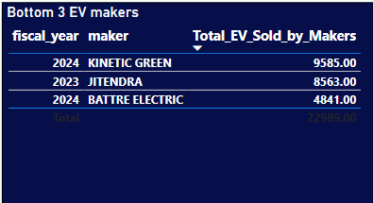
Q1. Top and Bottom 3 two-wheeler Electric Vehicle Sold by Electric Vehicle Manufacturing companies in FY23 and FY24

Slide 5
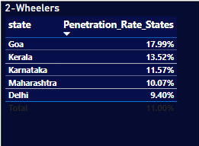
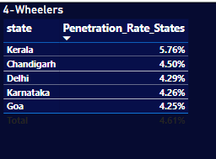
Q2. Top 5 States based on Penetration Rate in 2-Wheelers and 4-Wheelers EV Sales in FY24

Slide 6
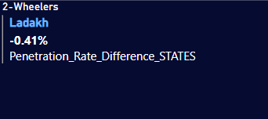
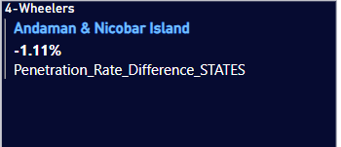
Q3. List the states with negative penetration (decline) in EV sales from 2022 to 2024?

Slide 7
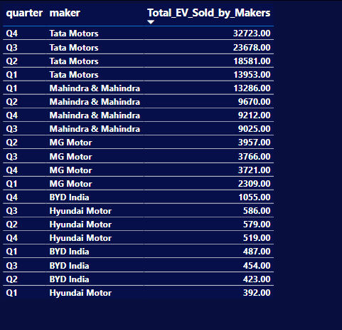
Q4. What are the quarterly trends based on sales volume for the top 5 EV makers (4-wheelers) from 2022 to 2024?

Slide 8
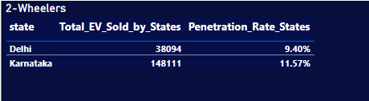
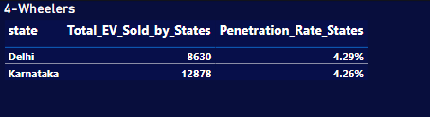
Q5. How do the EV sales and penetration rates in Delhi compare to
Karnataka for 2024?

Slide 9
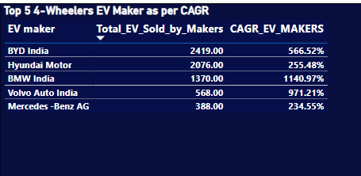
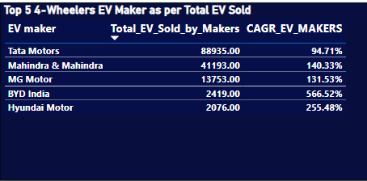
Q6. List down the compounded annual growth rate (CAGR) in 4-wheeler units for the top 5 makers from 2022 to 2024.

Slide 10
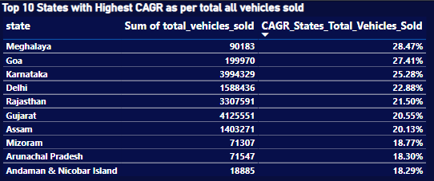
Q7. List down the top 10 states that had the highest compounded annual growth rate (CAGR) from 2022 to 2024 in total vehicles sold.

Slide 11
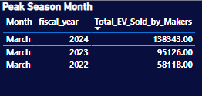
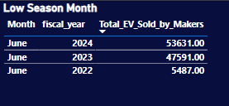
Q8. What are the peak and low season months for EV sales based on the data from 2022 to 2024?

Slide 12
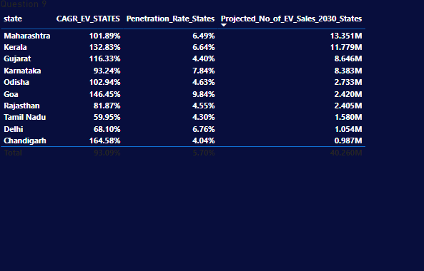
Q9. What is the projected number of EV sales (including 2-wheelers and 4-wheelers) for the top 10 states by penetration rate in 2030, based on the compounded annual growth rate (CAGR) from previous years?

Slide 13
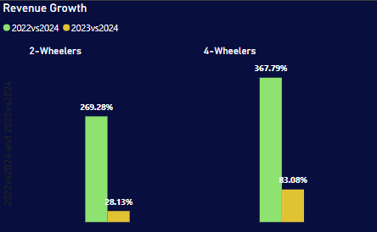
Q10. Estimate the revenue growth rate of 4-wheeler and 2-wheelers EVs in India for 2022 vs 2024 and 2023 vs 2024, assuming an average unit price.

Slide 14
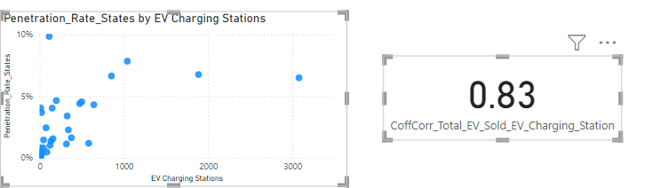
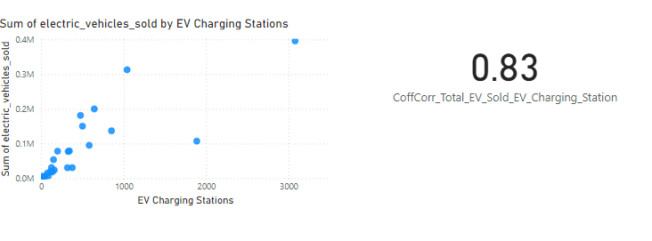
Q10. Estimate the revenue growth rate of 4-wheeler and 2-wheelers EVs in India for 2022 vs 2024 and 2023 vs 2024, assuming an average unit price.

Slide 15
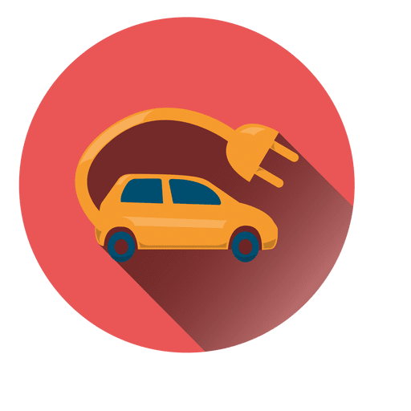
Secondary Question 1 :
Reason of choosing 4-wheeler EV in 2023 and 2024:
The year is 2023, and more and more Indians are turning to electric vehicles (EVs) for their daily commute. The reasons are both practical and visionary.
Cost-effectiveness:
Then there’s the economic aspect. While EVs may seem expensive upfront, their long-term savings are undeniable. With rising fuel costs and maintenance fees for traditional vehicles, the lower operating costs of EVs are appealing to both the wallet and the wallet-conscious.
Incentives: The Government of India is offering several incentives to encourage the purchase of 4-wheeler electric cars in 2023 and 2024:
A. FAME II Scheme: This provides subsidies to reduce the upfront cost of EVs, making them more affordable. B. Tax Benefits: Under Section 80EEB of the Income Tax Act, buyers can claim a deduction on the interest paid on loans taken for EV purchases.
C. State-Level Incentives: Various states offer additional subsidies, road tax exemptions, and registration fee waivers.
Environmental Concern: Consumers’ environmental sentiments significantly affect their desire to purchase alternative fuel vehicles. Many more studies have corroborated this. Many studies have supported this all claim that a person’s environmental concerns influence their purchasing behavior while it comes to business environment-friendly products

Slide 16
Secondary Question 2 : How do government incentives and subsidies impact the adoption rates of 2-wheelers and 4-wheelers? Which states in India provided most subsidies?
Impact of Government Incentives and Subsidies on Adoption Rates:
Lowering the Initial Cost: Subsidies help reduce the upfront cost of EVs, which are generally higher than internal combustion engine (ICE) vehicles. This makes EVs more attractive to price-sensitive consumers.
Boosting Consumer Confidence: Incentives such as reduced registration fees, road tax exemptions, and state-specific schemes increase consumer confidence, encouraging more people to switch to EVs.
Encouraging Manufacturing: Subsidies also support manufacturers by offering production-linked incentives (PLI) and tax breaks, encouraging more investment in electric mobility, which leads to wider availability and better infrastructure for EVs.
Accelerating Infrastructure Development: Government support for charging infrastructure (e.g., subsidies for setting up charging stations) is critical to improving convenience for EV owners. This addresses range anxiety, a major barrier to EV adoption.
Environmental Benefits: EV incentives align with government goals to reduce pollution, and consumers are encouraged to adopt environmentally friendly options, as they perceive a long-term cost-saving benefit.

Slide 17
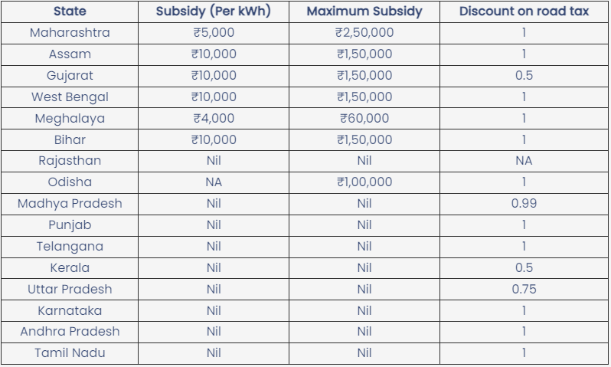
Government Subsidy on Electric Vehicles (Cars and SUVs):
Every state has its own criteria and policy for electric vehicles, so the state government's incentive for electric vehicles may vary. Below is the list of electric car subsidies in India:

Slide 18
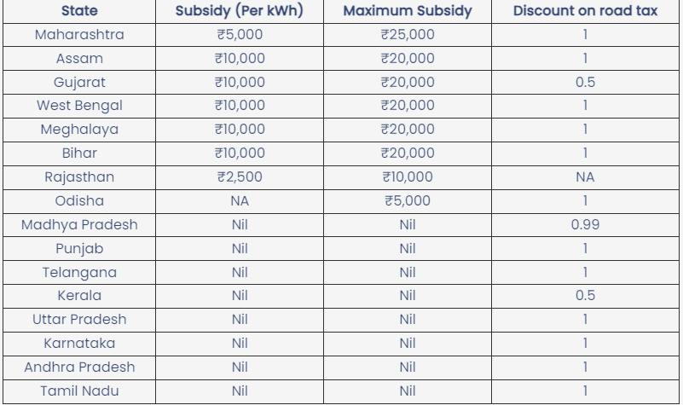
Government Subsidy on Electric Vehicles (Scooters and Bikes)
Like subsidies on EV cars and SUVs, electric scooters and bikes are eligible for state government subsidies. Below are the government subsidies on electric two-wheelers.

Slide 19
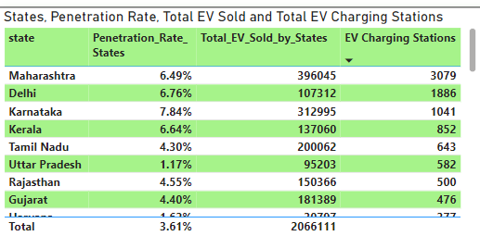
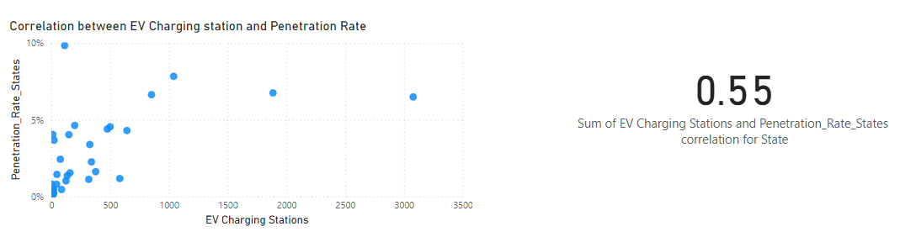
How does the availability of charging stations infrastructure correlate with the EV sales and penetration rates in the top 5 states?
The top 5 States like Maharashtra, Delhi, Karnataka, Kerala, Gujarat based to total number of Electric Vehicles sold in FY22, FY23, FY24 are having much higher number of EV Charging Stations than rest of the states. It clearly indicates that the sales of EV increases with the increment of EV Charging Stations. So, it shows a positive correlation.

Slide 20
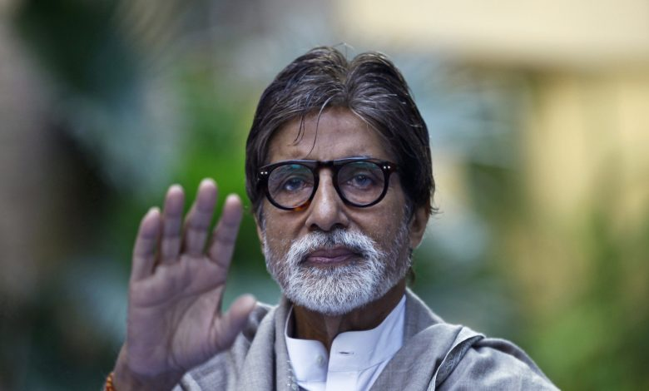
Q4. Who should be the brand ambassador if AtliQ Motors launches their EV/Hybrid vehicles in India and why?
Choosing a right brand ambassador is essential while launching any new product in a challenging yet diversified market like India. So, for vehicles market, my recommendation would be Amitabh Bachchan as the brand ambassador of Atliq Motors.
The reasons are:
Iconic Status: As one of the most respected and beloved figures in India, Amitabh brings a sense of trust and reliability to the brand.
Broad Demographic Reach: He appeals to multiple generations, ensuring the brand connects with a wide audience.
Enduring Influence: Amitabh’s longstanding presence in the industry can lend credibility and a sense of legacy to a new EV brand

Slide 21
Q5. Which state of India is ideal to start the manufacturing unit? (Based on
subsidies provided, ease of doing business, stability in governance etc.)
Gujarat is the ideal state to start the manufacturing unit of Electric Vehicles. The reasons supporting this statement are:
Subsidies and Incentives: Gujarat is one of the most forward states in providing financial incentives for EV manufacturers, including capital subsidies, tax rebates, and other financial incentives for setting up production plants.
Ease of Doing Business: Gujarat consistently ranks at the top in ease of doing business due to its investor-friendly policies, fast-track approvals, and simplified procedures in India.
Infrastructure: The state boasts excellent infrastructure, with well-connected industrial corridors, ports, and road networks, making it an ideal location for manufacturing units. Gujarat has also focused on developing industrial zones specifically for EVs.
Skilled Labor: Gujarat has a rapidly growing industrial workforce and is known for its strong presence in manufacturing, especially in the automotive sector.

Slide 22
Q6. Your top 3 recommendations for AtliQ Motors. The top 3 recommendations are:
Weather-friendly: In India, there are many places where water drainage system is poor and during monsoon, those roads become very pathetic for driving cars. This point should be reminded while manufacturing EVs.
Pricing: From grocery to consumer durables, Indian consumers are always driven by discounts. They always look for something which provides good value in comparatively lower cost. Atliq should develop their pricing strategy to lure the targeted audience in such a way that the audience will have a feeling of more cost savings in EV than diesel-cars. The audience must be saving the cost of diesel.
After-sales support: Indian consumers always value good after-sales support. Atliq must ensure and provide good after-sales support so that the customers can rely on them while buying EV.

